Slide 1


Case Study 5: Sustainable Agriculture with AI for Crop Yield Prediction
Enhancing Farming Efficiency with AI

Slide 2
TEAM
DHANAKRISHNA. V (Team Leader-S4F_CP_Team_11896)
GOWTHAM. P (Team Member-S4F_CP_Team_11896)
SELVAKUMAR. S (Team Member-S4F_CP_Team_11896)
DHANUSH. G (Team Member-S4F_CP_Team_11896)
BADHRIKRISHNAN. B (Team Member-S4F_CP_Team_11896)

Slide 3
Content
Abstract
Problem Statement
Objective
Data Collection and Preparation
Proposed Solution (Methodology)
Model Performance Evaluation
Screenshots / Demonstration (video)
Future Scope
Conclusion
Notes:
Abstract
Problem Statement (Clearly define the challenge)
Objective (State your project's goal)
Background and Research (Discuss existing solutions, trends, and gaps)
Data Collection and Preparation (Focus on data sources, cleaning, and augmentation)
Proposed Solution (Methodology)
Model Architecture (e.g., CNN, U-Net, YOLOv5)
Key Techniques (e.g., Transfer Learning, Image Augmentation)
Model Performance Evaluation
Metrics (Accuracy, Precision, Recall, IoU, etc.)
Graphs (Confusion Matrix, ROC Curve, etc.)
Screenshots / Demonstration (Visual proof of system functionality)
Future Scope (Improvements, scalability, and integration ideas)
Conclusion (Summarize results and impact)
Q&A Session

Slide 4
Abstract
Agriculture is highly influenced by environmental factors like temperature, rainfall, and soil quality, making accurate crop yield prediction essential, especially in the face of climate change. AI-driven solutions analyze historical data and environmental conditions to provide precise yield forecasts, helping farmers optimize resources, reduce waste, and improve productivity. By leveraging machine learning and deep learning techniques, AI enhances decision-making, minimizes water consumption, and increases crop yields, promoting sustainable agriculture. This approach not only supports climate resilience but also contributes to global food security.

Slide 5
Problem Statement
Agriculture is highly dependent on environmental factors like temperature, rainfall, and soil quality.
Climate change impacts agricultural productivity and sustainability.
Farmers need accurate predictions for crop yields to optimize resource usage and minimize waste.
AI can analyze historical data and environmental factors to forecast yields and recommend best farming practices.

Slide 6
Objective
Develop an AI-based model to predict crop yields.
Utilize historical data and environmental factors to improve decision-making.
Help farmers optimize resources like water, fertilizer, and labor.
Promote sustainable agriculture by reducing environmental impact.

Slide 7
Data Collection and Preparation
Dataset Includes:
Historical crop yield data
Soil quality parameters
Rainfall and temperature readings (5-year period)
Data Preprocessing:
Handling missing values
Normalization and feature selection
Splitting data into training and testing sets

Slide 8
Proposed Solution (Methodology)
Data Acquisition: Collect historical and real-time agricultural data.
Feature Engineering: Select key factors influencing crop yield (e.g., soil pH, temperature, rainfall).
Model Selection:
Machine Learning (Random Forest, Decision Trees, Neural Networks)
Deep Learning models (LSTMs for time-series predictions)
Model Training & Evaluation: Train using past data, test accuracy using evaluation metrics (R2 Score, RMSE).
Deployment: Provide farmers with predictive insights through an interactive dashboard or mobile app.

Slide 9
Model Performance Evaluation
Compare different AI models based on accuracy, precision, and recall.
Key metrics used for evaluation:
Mean Squared Error (MSE)
Root Mean Squared Error (RMSE)
R-squared Score (R2)
Visualization of model predictions vs. actual values.

Slide 10
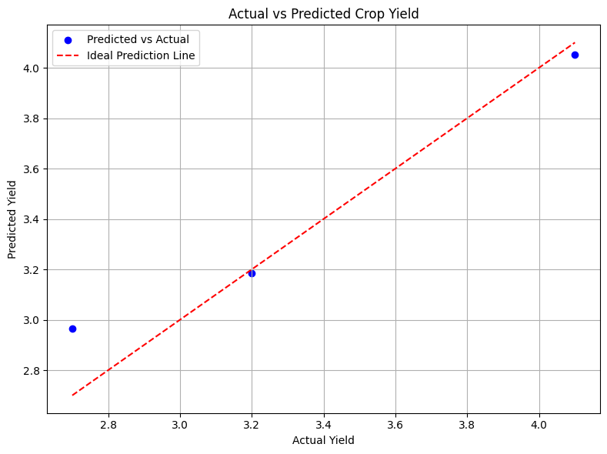
Screenshots / Demonstration (video)
Github Link : https://github.com/Dhanakrishnan1234/AI-AND-GREENSKILL-CASE-STUDY-5

Slide 11
Future Scope
Expanding the dataset for better accuracy.
Integrating IoT sensors for real-time data collection.
Deploying AI solutions via mobile applications for easy farmer access.
Collaboration with governments for large-scale implementation.
Research on AI-driven climate resilience strategies for crops.

Slide 12
1. How can AI help farmers increase crop yields while reducing environmental impact?
AI helps farmers enhance productivity while minimizing ecological harm through:
Precision agriculture: Uses AI with drones, sensors, and satellite data to monitor crop health and soil conditions in real-time.
Smart irrigation and fertilization: AI systems optimize water and fertilizer use, reducing waste and overuse.
Pest and disease prediction: AI models detect early signs of pest infestations or diseases, enabling targeted intervention.
Weather forecasting: Predictive models help schedule planting and harvesting at optimal times.
Yield forecasting: AI analyzes environmental and crop data to estimate expected yields, allowing for better planning and resource use.

Slide 13
2. Develop a model to predict crop yields based on soil and weather data.
Collect data on soil (pH, nitrogen, phosphorus, potassium, moisture), weather (temperature, rainfall, humidity, sunlight), and crops (type, past yields).
Preprocess data by handling missing values, scaling features, encoding categories, and splitting into training and testing sets.Select key variables like soil pH, nitrogen, rainfall, and temperature to improve model focus.
Prioritize influential factors to enhance yield prediction accuracy.

Slide 14
3. What steps can farmers take based on the model’s predictions to optimize their resources?
Based on model predictions, farmers can:
Adjust fertilizer levels to match crop nutrient needs and avoid overuse.
Plan irrigation schedules more efficiently, reducing water waste.
Select optimal crop varieties for expected soil and weather conditions.
Time planting and harvesting to avoid losses from poor weather.
Allocate land and labor more effectively for high-yield potential crops.
Use precision spraying to target pest-prone areas only.
These actions lead to better yields, lower costs, and reduced environmental impact.

Slide 15
4. How can AI solutions like this contribute to global food security?
AI contributes to global food security by:
Boosting productivity through data-driven insights, even on small farms.
Reducing crop loss via early detection of threats and improved planning.
Helping adapt to climate change with predictive models that guide farming under shifting conditions.
Enabling efficient land use, ensuring maximum output from limited space.
Supporting policy decisions with accurate agricultural data for supply chain and food distribution management.
By making farming more efficient and resilient, AI plays a key role in feeding a growing global population.

Slide 16
5. Discuss how AI can be used to promote sustainable agricultural practices in developing countries.
In developing countries, AI promotes sustainable farming by:
Providing low-cost decision tools via mobile apps for weather forecasting, pest alerts, and crop recommendations.
Guiding regenerative agriculture, such as crop rotation and organic fertilization, using data-driven strategies.
Enhancing market access through AI-powered platforms that connect farmers to buyers and fair pricing.
Training farmers with AI chatbots and tools in local languages for personalized advice.
These solutions empower small-scale farmers with technology, leading to long-term sustainability and economic upliftment.

Slide 17
Conclusion
AI-based crop yield prediction can revolutionize farming.
Farmers can make data-driven decisions to enhance productivity.
Sustainable farming is achievable through AI-driven insights.
Adoption of AI in agriculture can contribute to global food security.

